Slide 1
Digital Portfolio
✳️STUDENT NAME: VASANTH S
✳️REGISTER NO : 24131081802521077
✳️ NMID: 𝗮𝘀𝗮𝗻𝗺10824131081802521077
✳️DEPARTMENT: BSC-COMPUTER SCIENCE
✳️COLLEGE: COLLEGE/ UNIVERSITY: THIRU KOLANJIAPPAR GOVERNMENT ARTS COLLEGE/ANNAMALAI UNIVERSITY.

Slide 2
PROJECT TITLE
To create a student portfolio

Slide 3
AGENDA
✳️1.Problem Statement
✳️2.Project Overview
✳️3.End Users
✳️4.Tools and Technologies
✳️5.Portfolio design and Layout
✳️6.Features and Functionality
✳️7.Results and Screenshots
✳️8.Conclusion

Slide 4
PROBLEM STATEMENT
✳️Students often struggle to present their skills, achievements,
and projects in a structured and visually appealing way.
✳️Traditional resumes lack creativity and do not highlight
individual strengths effectively.
✳️Hence, there is a need for a digital student portfolio that combines design, functionality, and accessibility.

Slide 5
PROJECT OVERVIEW
✳️This project focuses on designing and developing a personal
digital portfolio for students using HTML, CSS, and Java.
✳️The portfolio acts as a professional platform where students can
showcase their academic background, skills, certifications, and
projects in an interactive and organized manner.

Slide 6
WHO ARE THE END USERS?
✳️The digital portfolio is mainly designed for:
✳️Students – to showcase talents, projects, and academic
growth.
✳️Teachers & Mentors – to evaluate student performance in a
structured way.
✳️Recruiters/Companies – to identify skilled candidates for
internships and jobs.

Slide 7
TOOLS AND TECHNIQUES
✳️HTML – for structuring the content.
✳️CSS – for creating a professional and responsive design.
✳️Java – for adding dynamic features and improving functionality.

Slide 8
POTFOLIO DESIGN AND LAYOUT
✳️The portfolio is built with a clean, responsive, and user-
friendly design. It contains sections for personal details, skills,
education, projects, and achievements.
✳️The layout is carefully designed to maintain balance between text, visuals, and
navigation, ensuring a professional first impression.

Slide 9
FEATURES AND FUNCTIONALITY
✳️Responsive design for mobile and desktop viewing.
✳️Organized sections for personal, academic, and project details.
✳️Interactive navigation for smooth user experience.
✳️Attractive color themes and typography for professional presentation.
✳️Dynamic components powered by Java for better interactivity.

Slide 10
RESULTS AND SCREENSHOTS
✳️The final output is a fully functional digital portfolio that represents a student’s complete academic and personal profile in an elegant manner. ✳️Screenshots demonstrate the homepage, skills section, project gallery, and contact page, reflecting a professional online identity.

Slide 11
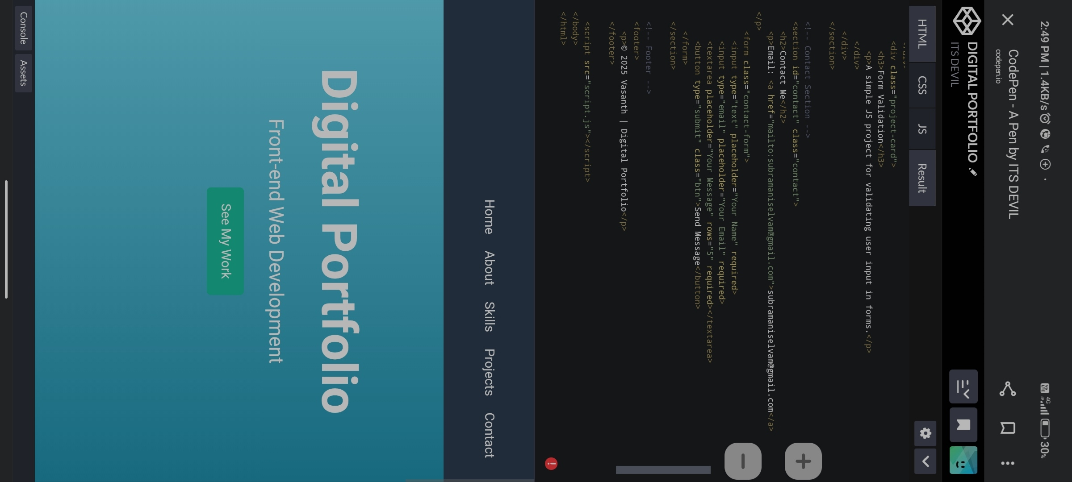

Slide 12
CONCLUSION
✳️The student portfolio project successfully demonstrates how
web technologies can be used to create a professional digital identity.
✳️It not only helps students showcase their abilities but also prepares them
for future academic and career opportunities by making their achievements easily accessible online.

